Slide 1

Vank
VIRTUAL ASSISTANT FOR YOUR BANK

Slide 2

THE PROBLEM
High costs for banks
20.000.000 EUROS / YEAR SPEND ON CALL CENTERS SERVICES

Slide 3

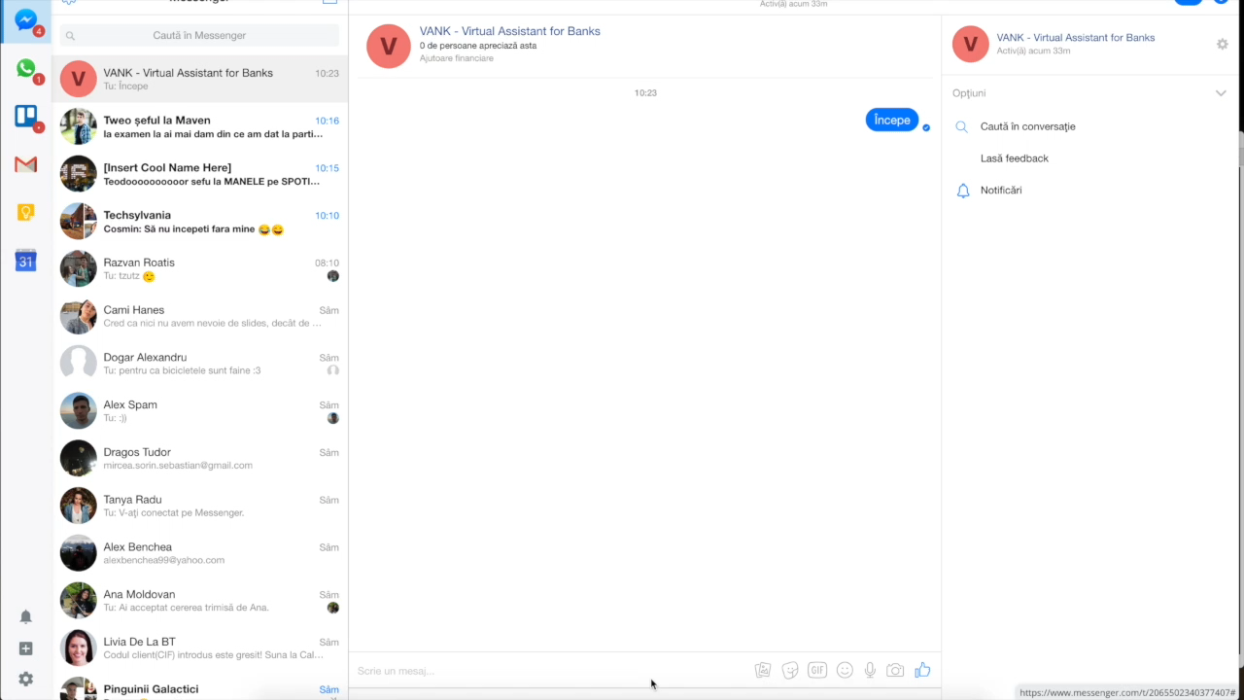
🤖
THE solution

Slide 4
THE solution - features
A virtual Assistant Software for Banks
24/7 Customer support
Account balance
Cost reduce by 30%

Slide 5
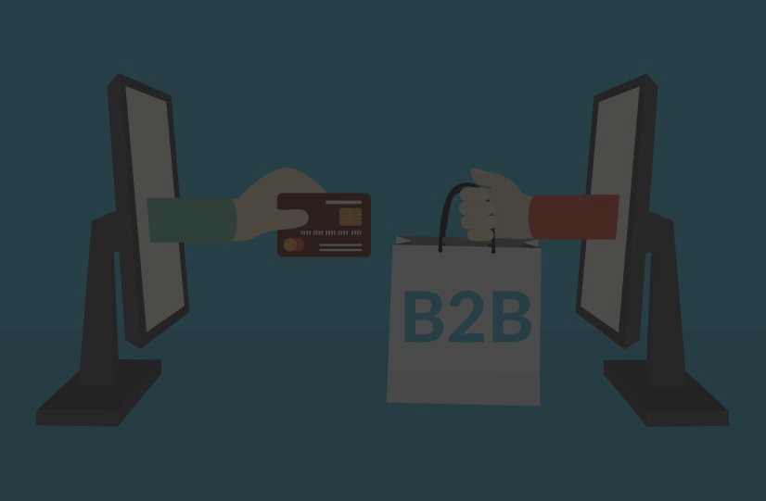
BUSINESS MODEL
B2B - subscription + engagement based + trial 💵
Target are the banks

Slide 6

Competitive advantages
Cost reduction
Security
Low risk interaction flow
Human like interaction (text + voice)
Employee & business analytics 📈
Exposure

Slide 7


With from Duty Labs team
Made in Cluj-Napoca
:)

